Slide 1

Human resources slide 1
ENG 5044- INTEGRATED SYSTEM DESIGN PROJECT:
A RENEWABLE ENERGY SOLUTION FOR THE ISLAND OF GREAT CUMBRAE

Slide 2
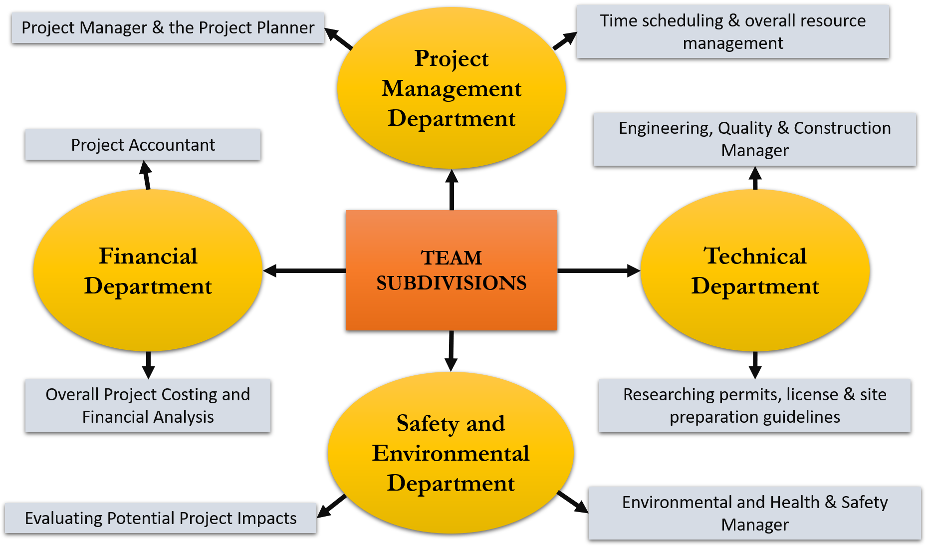
1. Team Division

Slide 3
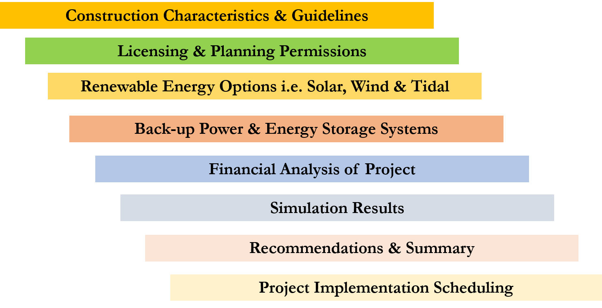
2. Research Phases
Solar and tidal not feasible options
Pumped Hydro not feasible option

Slide 4


3. Significant Milestones to Date
Cloud-based online Project Management
Power & Energy Production System:
Simulations using HOMER
Field trip: contact with Local Council Chairman, sent questionnaire.
Geographical review of the island for the project, taking soil samples for analysis.
Wind Turbines
Battery Storage
Hydrogen Production System

Slide 5
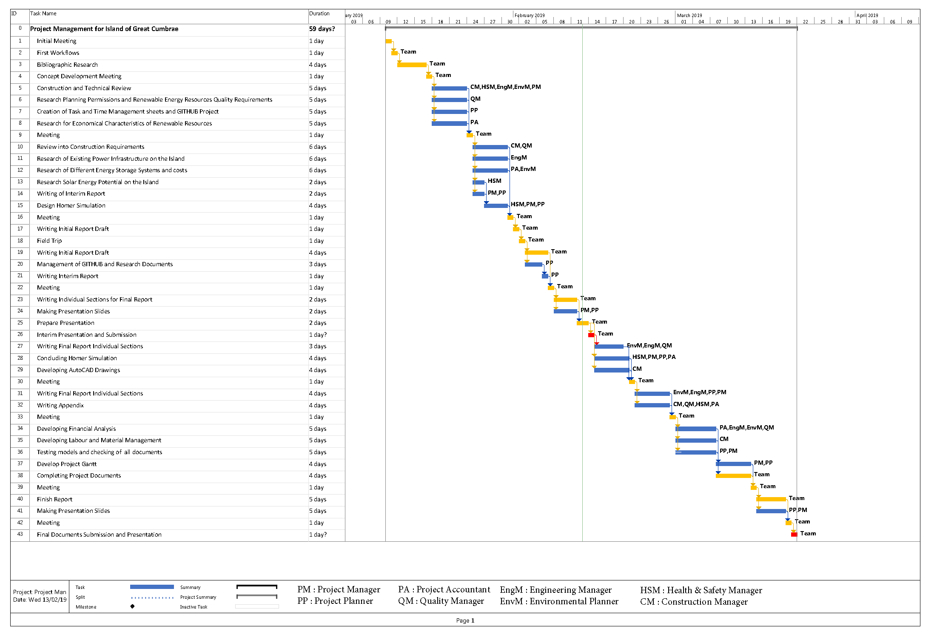
4. Research Gantt Chart

Slide 6

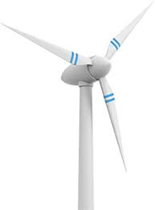
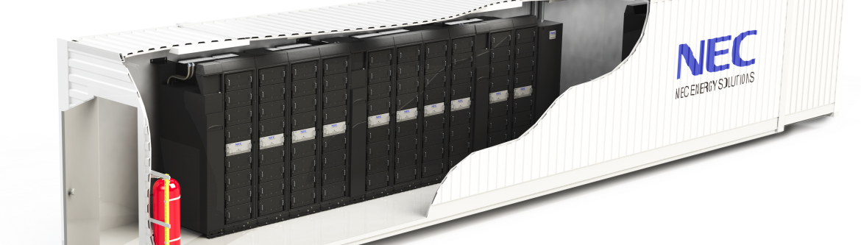
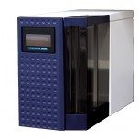
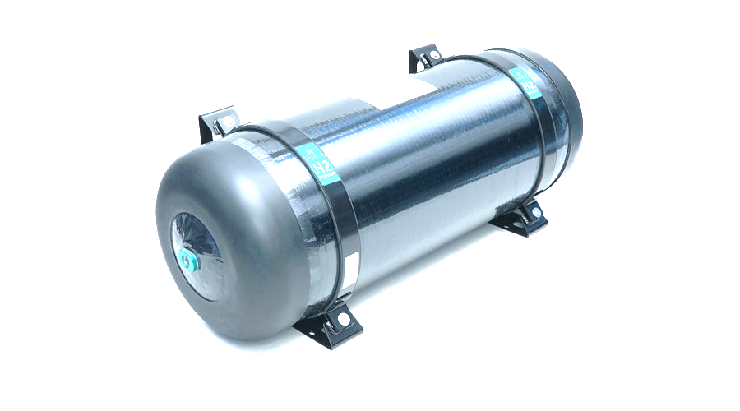
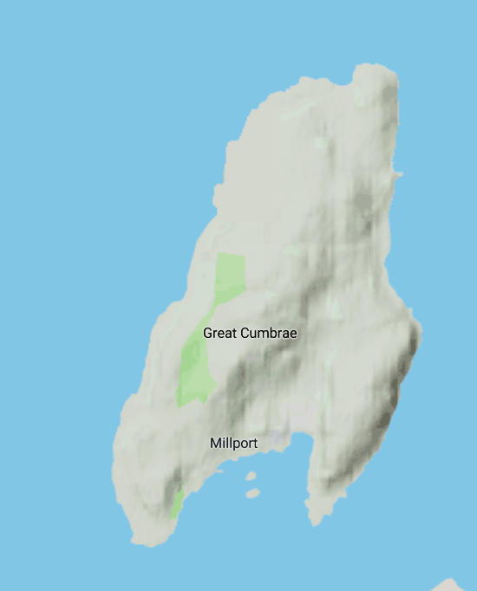
5. Project Implementation
Data | Value
Population | 1376
Electricity Demand | 9.4 GWh per year
Power generation | 20 GWh per year

